Slide 1



Progress Report on the Bipedal Robot Project
Material organization and future plans
Presenter
date：2026/3
Notes:
大家好，欢迎参加本次双足机器人项目的进展报告会。今天，我将向大家汇报我们项目目前的材料整理情况，并详细介绍我们下一阶段的未来工作计划。虽然项目刚刚起步，我们还没有实物成果，但我们已经在理论研究和方案规划上做了充分的准备。

Slide 2






CONTENTS
01.Project Background and Objectives
02. Review of Preliminary Work
03. Material organization and analysis
04. Future plan
05. Summary and Outlook
Notes:
本次报告将分为五个部分。首先，我会介绍项目的背景和我们设定的核心目标。接着，回顾我们在项目初期已经完成的一些关键工作。然后，重点展示我们目前在机械、电子和软件方面所做的材料整理与分析。之后，将详细阐述我们为未来制定的分阶段工作计划。最后，对整个项目进行总结并展望未来的发展方向。

Slide 3


Project Background and Objectives - Core Objective
short target：Fundation and walking
long-term aim
Complete the mechanical structure design and hardware setup of a 6-degree-of-freedom biped robot, achieving stable straight-line walking posture, and laying the physical foundation for the project.
Based on the basic platform, conduct in-depth exploration of more complex gait planning algorithms and environmental perception capabilities, achieving obstacle avoidance functions and the ability to identify specific objects.
Notes:
基于此背景，我们设定了清晰的项目目标。短期来看，我们的首要任务是完成一个6自由度双足机器人的设计与制作，并让它能够实现最基本的稳定行走。而从长远来看，我们希望在这个基础平台上，不断探索和优化控制算法，最终实现更智能、更灵活的运动能力。

Slide 4



Review of Preliminary Work - Scheme Determination
6-degree-of-freedom bipedal structure design
Degree of Freedom Allocation Scheme
Each leg consists of 3 core degrees of freedom: the forward-backward and left-right swinging of the hip joint, as well as the bending of the knee joint. In total, there are 6 degrees of freedom.
advantages
Adopting a classic minimalist architecture, while ensuring the basic movement capabilities, significantly reduces the complexity of mechanical design and control algorithms. It is an ideal platform for beginners' research.
Notes:
在项目的前期，我们完成了关键的方案确定工作。如图所示，我们选择了一个经典的6自由度设计，每条腿有3个关节，分别控制前后、左右和屈膝动作。这个方案是经过充分考虑的，它在功能和复杂度之间取得了很好的平衡，是我们项目起步的理想选择。

Slide 5
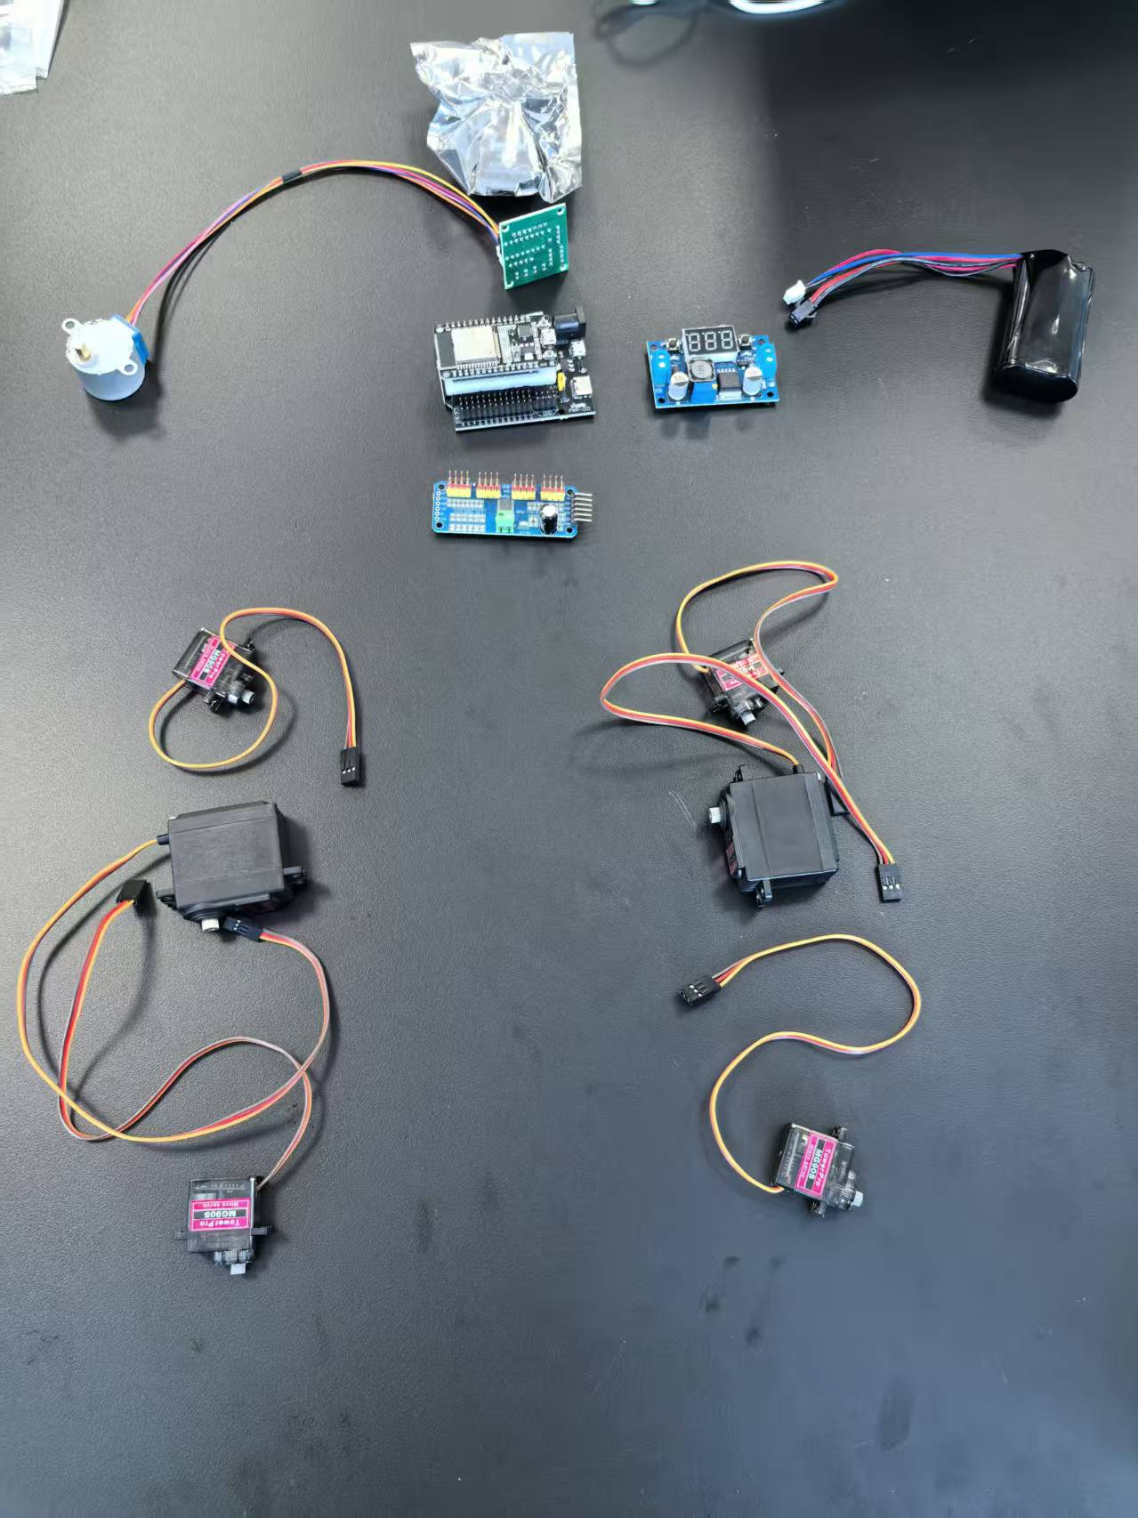


plan
design graph
Notes:
在项目的前期，我们完成了关键的方案确定工作。如图所示，我们选择了一个经典的6自由度设计，每条腿有3个关节，分别控制前后、左右和屈膝动作。这个方案是经过充分考虑的，它在功能和复杂度之间取得了很好的平衡，是我们项目起步的理想选择。

Slide 6
Review of Preliminary Work - Selection of Key Components
Control and Vision Categories
heart:ESP32 开发板 (ESP32 DevKit V1)
modue:ESP32-CAM (with OV2640 camera)
Sensor and Drive Components
Posture balance sensor:GY-521 MPU6050 model
Multi-channel Servo Driver Board:PCA9685 (16path 12-bit)
Power joints (muscles)
Medium-sized main steering gear (6 units):MG996R (180)，size：wide 20mm x long 40.5mm
Miniature auxiliary servo motors (4 units):MG90S (180)，size：long 32mm * wide 23mm * tall 12.1mm
Energy and Power Supply Category
High-power voltage reduction module:LM2596S (with number screen)，size：39 * 66mm
Main power supply lithium battery pack:LB218B (7.4V)，size：long 69mm * wide 37mm * tall 18.8mm
Notes:
另一个重要的前期工作是核心部件的选型。我们深入对比了舵机和步进电机的优缺点，最终选择了舵机。原因很简单：舵机自带角度反馈和闭环控制，我们只需要发送一个信号，它就能精确地转到指定角度，这对于控制机器人关节来说是完美的选择。我们初步选定了MG90S这款舵机，它体积小、扭矩适中，完全能满足我们的需求。

Slide 7





Future Work Plan - Phase 1: Mechanical Modeling
step aim
Complete the 3D model design and engineering drawing output of the robot, ensuring the rationality of the structure.
Specific task breakdown
use SolidWorks
Create 3D models of each component of the robot (such as the lower legs)
Carry out virtual assembly, check the interference between components and optimize the design.
Output engineering drawings (2D views) for processing purposes
time
plan：2weeks (Week 1 - Week 2)
3D model
Notes:
基于目前的准备工作，我们制定了详细的未来计划。第一阶段，我们将集中精力进行机械建模。在接下来的两周内，我们的目标是完成整个机器人的3D设计，并输出可以用于实际加工的工程图纸。

Slide 8






Future Work Plan - Phase 1: Task Decomposition
1 week
2 week
Software Foundation Learning
Be familiar with the interface and core operation logic of the modeling software, and master the basic commands.
Virtual assembly and interference check
Assemble the components, check for spatial interference, and ensure the structural rationality.
Component 3D modeling
Based on the design drawings, independently complete the 3D model drawing of all key components.
Model modification and optimization
Iterate the design based on the inspection results to enhance the model's accuracy and performance.
Notes:
这是第一阶段任务的详细分解和时间线。我们将用一周时间学习软件并完成建模，第二周进行装配、检查和图纸输出。通过这样的规划，我们希望能高效、有序地完成第一阶段的目标。

Slide 9

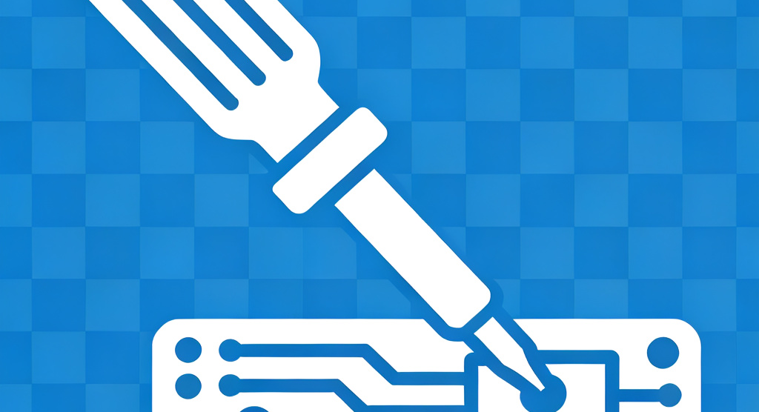


Future Work Plan - Phase Two: Hardware Setup
aim
Complete the hardware assembly of the robot, ensuring that the structure is stable and the circuit connections are normal.
task
Process the mechanical components required according to the engineering drawings
Assemble the mechanical structure of the robot, install the servo motors and conduct initial debugging
Carry out hardware integration testing to ensure correct connections and normal communication of all components
time plan
consume：2weeks
Notes:
完成3D建模后，我们将进入第二阶段——硬件搭建。这个阶段，我们会把设计图变成实物，包括采购零件、组装机械结构、焊接电路等。预计两周时间，我们就能看到机器人的雏形了。

Slide 10









Future Work Plan : Task Decomposition and Timeline
1-3week: fundation
4-8week：test
9-10week：Optimization
Drive development
Write the servo drive and basic control code, and establish the hardware communication interface.
Software and hardware integration testing
Resolve the issue of control accuracy and ensure real-time system response.
Parameter optimization
Optimize the control algorithm based on test data to enhance gait stability.
Prototype of the algorithm
Design and implement the initial gait algorithm to verify its theoretical feasibility.
Stage acceptance
Achieve stable walking and complete the set goals of the third stage.
Functional testing
Test the walking function, record abnormal data, and use it as a basis for optimization.
Notes:
第三阶段的工作将分为三步：首先编写基础的控制代码，然后实现步态算法，最后进行长时间的联调和优化。我们相信，通过这三周的努力，一定能让机器人迈出稳健的第一步。

Slide 11


Summary and Outlook
Project Summary: Strengthening the Foundation
Future Outlook: Intelligent Upgrade
Scheme Design: Completed the overall architecture design of the biped robot and selected the key components.
Theoretical Foundation: Conducted comprehensive data collection and analysis on mechanical structure, electronic control, and software algorithms.
Current Status: Currently in the preparatory stage, laying a solid foundation for subsequent implementation.
Perception Enhancement: Integrating ultrasonic and infrared sensors to achieve autonomous obstacle avoidance functionality.
Motion Optimization: Iterative gait algorithm to pursue a more natural and efficient bipedal walking experience.
Human-Machine Interaction: Incorporating a visual recognition module to explore the possibilities of human-machine interaction.
Notes:
最后，对本次报告进行总结。目前我们的项目正处于一个良好的开端，完成了充分的前期准备。展望未来，这个基础的双足机器人平台还有很大的扩展空间，我们可以为它增加避障、视觉等功能，让它变得更加智能。我们对项目的未来充满信心。

